Slide 1
JOINS & UNIONS IN SQL
James Larkin – Data Analytics Instructor

Slide 2
JOINS & UNIONS IN SQL
OPENING

Slide 3
LEARNING OBJECTIVES
JOINS & UNIONS IN SQL
Learn the SQL tools for appending similar data together.
Explore combining data from different tables together.
Use the SQL commands JOIN and UNION to answer data questions.
Introduce the SQL structure to JOIN data from multiple sources.

Slide 4
JOINS & UNIONS IN SQL
INTRODUCTION: UNIONS AND JOINS

Slide 5
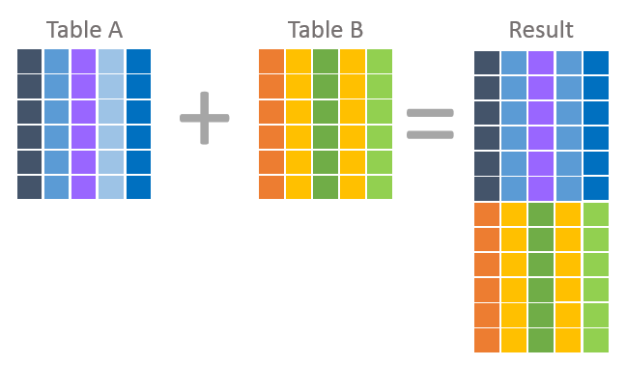
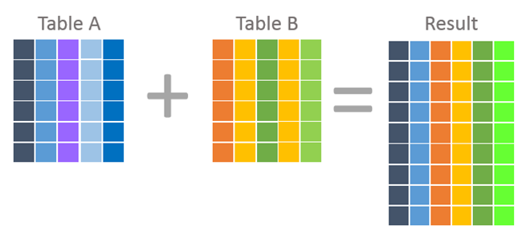
UNIONS AND JOINS: ILLUSTRATION
A UNION merges rows of similar data to create a new set.
A JOIN combines columns from tables using common unique identifiers (keys).
Source: essentialSQL, https://goo.gl/FQXykj

Slide 6
JOINS & UNIONS IN SQL
DEMO: UNIONS

Slide 7
UNIONS: CASE USES
UNION is great when you need to stack tables.
For example, is sales data is logged in separate monthly tables but you need to look at a few months together.
Another use is when staff list are kept separate by department but HR needs to look at all of them together.
The key is to have the same number of columns and each column matches datatype.

Slide 8
UNIONS: SAMPLE CODE STRUCTURE
Let’s look at some simple mock syntax for a UNION:
SELECT field1
FROM table1
WHERE field1= X
UNION
SELECT Field1
FROM table2
WHERE field1= X
ORDER BY 1

Slide 9
JOINS & UNIONS IN SQL
GUIDED PRACTICE: UNIONS

Slide 10
THREE TYPES OF UNIONS: MERGING TWO TABLES
We’ll build three different examples of UNIONs:
A table UNION.
A column UNION.
A combination of the two.
We’ll be using the following sample HR tables for illustration:
Employees1 Employees2
id | first_name | last_name | current_salary
2 | Gabe | Moore | 50000
3 | Doreen | Mandeville | 60000
5 | Simone | MacDonald | 55000
id | first_name | last_name | current_salary
7 | Madisen | Flateman | 75000
11 | Ian | Paasche | 120000
13 | Mimi | St. Felix | 70000

Slide 11
THREE TYPES OF UNIONS: MERGING TWO TABLES
A table UNION includes selections from different tables:
SELECT * FROM Employees1 UNION SELECT * FROM Employees2
id | first_name | last_name | current_salary
2 | Gabe | Moore | 50000
3 | Doreen | Mandeville | 60000
5 | Simone | MacDonald | 55000
id | first_name | last_name | current_salary
7 | Madisen | Flateman | 75000
11 | Ian | Paasche | 120000
13 | Mimi | St. Felix | 70000
id | first_name | last_name | current_salary
2 | Gabe | Moore | 50000
3 | Doreen | Mandeville | 60000
5 | Simone | MacDonald | 55000
7 | Madisen | Flateman | 75000
11 | Ian | Paasche | 120000
13 | Mimi | St. Felix | 70000

Slide 12
THREE TYPES OF UNIONS: MERGING TWO TABLES
A column UNION is when you UNION columns from the same table together:
SELECT first_name FROM Employees1
UNION
SELECT last_name FROM Employees1
id | first_name
2 | Gabe
3 | Doreen
5 | Simone
2 | Moore
3 | Mandeville
5 | MacDonald
id | first_name | last_name | current_salary
2 | Gabe | Moore | 50000
3 | Doreen | Mandeville | 60000
5 | Simone | MacDonald | 55000

Slide 13
THREE TYPES OF UNIONS: MERGING TWO TABLES
A combination of column and table unions brings together specific columns from two different tables:
SELECT first_name FROM Employees1
UNION
SELECT last_name FROM Employees1
UNION
SELECT first_name FROM Employees2
UNION
SELECT last_name FROM Employees2
id | first_name
2 | Gabe
3 | Doreen
5 | Simone
2 | Moore
3 | Mandeville
5 | MacDonald
7 | Madisen
11 | Ian
13 | Mimi
7 | Flateman
11 | Paasche
13 | St. Felix

Slide 14
UNION ORDERING
The UNION operator may place the rows in the first query before, after or between the rows in the result set of the second query. To sort the rows in the combined result set by a specified column, you use the ORDER BY clause.

Slide 15
UNION RULES
Remember these four rules when using UNION:
You must match the number of columns and they must be of compatible data types.
You can only have one ORDER BY at the bottom of your full SELECT statement.
UNION removes exact duplicates; UNION ALL allows duplicates.
Conditions between UNION SELECT statements should match.
Pro Tip: While you may find yourself altering these rules in practice, keep in mind that this may damage your data integrity.
Notes:
Instructor Note: Students frequently ask questions about why UNION SELECT statements should not be altered. Consider providing additional explanations here.

Slide 16
JOINS & UNIONS IN SQL
INTRODUCTION: JOINS

Slide 17
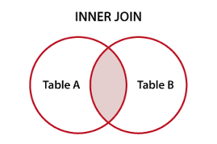
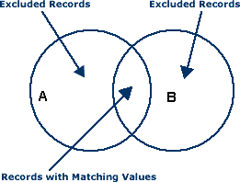
JOINS
SQL JOINs and Excel’s VLOOKUP command have similar purposes. They both connect data sources together in order to use information from both tables to display a desired result.
For large relational or object-oriented databases, a JOIN enables tables to be connected using common columns, which serve as unique identifiers, or KEYS.
We’ll start by looking at some inner JOINs.
Excluded Records
Excluded Records
Records with Matching Values

Slide 18
JOINS & UNIONS IN SQL
DEMO: JOIN SYNTAX

Slide 19
JOINS SYNTAX, EXPLAINED
First ⇨ Identify which columns of information you are targeting.
Second ⇨ Identify the table from which to retrieve information.
Third ⇨ Specify the keys, or common columns that you wish to join together.
SELECT
s.salesorderdetailid,
s.salesorderid,
s.orderqty,
p.name
FROM sales.salesorderdetail AS s
INNER JOIN production.product AS p
ON s.productid = p.productid;
sales.salesorderdetail
PK PK | salesorderid salesorderdetailid
FK1 FK2 FK3 FK4 | productid specialofferid rowguid carriertrackingnum
production.product
PK | productid
FK1 FK2 FK3 | productsubcategoryid productmodelid rowguid
Notes:
An illustration of bringing data together.

Slide 20
JOINS SYNTAX, EXPLAINED
When you create a JOIN, each table can have an ALIAS and each COLUMN is connected to the TABLE by the ALIAS.
An ALIAS is a shorthand name given to tables or columns in a table that you intend to reference repeatedly. Here, each column is connected to the table via an ALIAS.
table1 AS a → a.column1 table1 uses the alias a.
table2 AS b → b.column4 table2 uses the alias b.

Slide 21
JOINS SYNTAX, EXPLAINED
Next, specify the type of JOIN you want. An INNER JOIN is used by default.
Specify the connection, by column name, on which you want to link tables.
ON a.column_name1 = b.column_name4 → With alias for source table.
USING(column_name) → Only if the columns have same name in each table.

Slide 22
JOINS & UNIONS IN SQL
GUIDED PRACTICE: JOINING SALES TO PRODUCTS

Slide 23

JOINING SALES (salesorderdetail) TO PRODUCT
Let’s alter this code a bit so it will work better:
SELECT b.productid, b.name, a.unitprice
FROM the salesorderdetail table and the product table.
Next, write a query to perform the following:
Find the common field on which to JOIN them.
Limit results to the first 1000
EXERCISE
Notes:
SOLUTION
SELECT Top 1000
b.item_no, b.item_description, a.total
FROM sales a
INNER JOIN products b
ON a.item = b.item_no

Slide 24
JOINING SALES (salesorderdetail) TO PRODUCT
Solution:
SELECT
b.productid,
b.name,
a.unitprice
FROM sales.salesorderdetail AS a
INNER JOIN production.product AS b
USING (productid);
EXERCISE
Notes:
SOLUTION
SELECT
b.productid,
b.name,
a.unitprice
FROM sales.salesorderdetail AS a
INNER JOIN production.product AS b
USING (productid);

Slide 25
JOINING SALES (salesorderheader) TO TERRITORY (salesterritory)
Write a query to discover which DISTINCT orders were sold in Europe
Return the salesorderid and group (continent), name (country) columns.
Qualify DISTINCT
Select appropriately aliased items FROM the salesorderheader and salesterritory tables.
Connect the matching columns with the USING structure.
EXERCISE

Slide 26
JOINING SALES (salesorderheader) TO TERRITORY (salesterritory)
Sample Solution: DISTINCT sales in Europe
SELECT DISTINCT ss.salesorderid,
st.group,
st.name
FROM sales.salesorderheader AS ss
INNER JOIN sales.salesterritory AS st
USING (territoryid)
WHERE st.group ILIKE 'europe';
EXERCISE
Notes:
SOLUTION 8,514 rows returned

Slide 27
JOINS & UNIONS IN SQL
GUIDED PRACTICE: JOINING MULTIPLE TABLES

Slide 28
JOINING MULTIPLE TABLES
Here’s an example of joining multiple tables together. Notice that the code repeats itself.
Tip: It can be helpful to sketch and wireframe how your JOINs will relate on a piece of paper before coding.
SELECT b.field1, a.field2, a.field3, c.field4
FROM table1 a
INNER JOIN table2 b
ON a.field1 = b.field1
INNER JOIN table3 c
ON a.field1 = c.field1
ORDER BY b.field1

Slide 29
JOINS & UNIONS IN SQL
INDEPENDENT PRACTICE:
JOINING MULTIPLE
TABLES

Slide 30
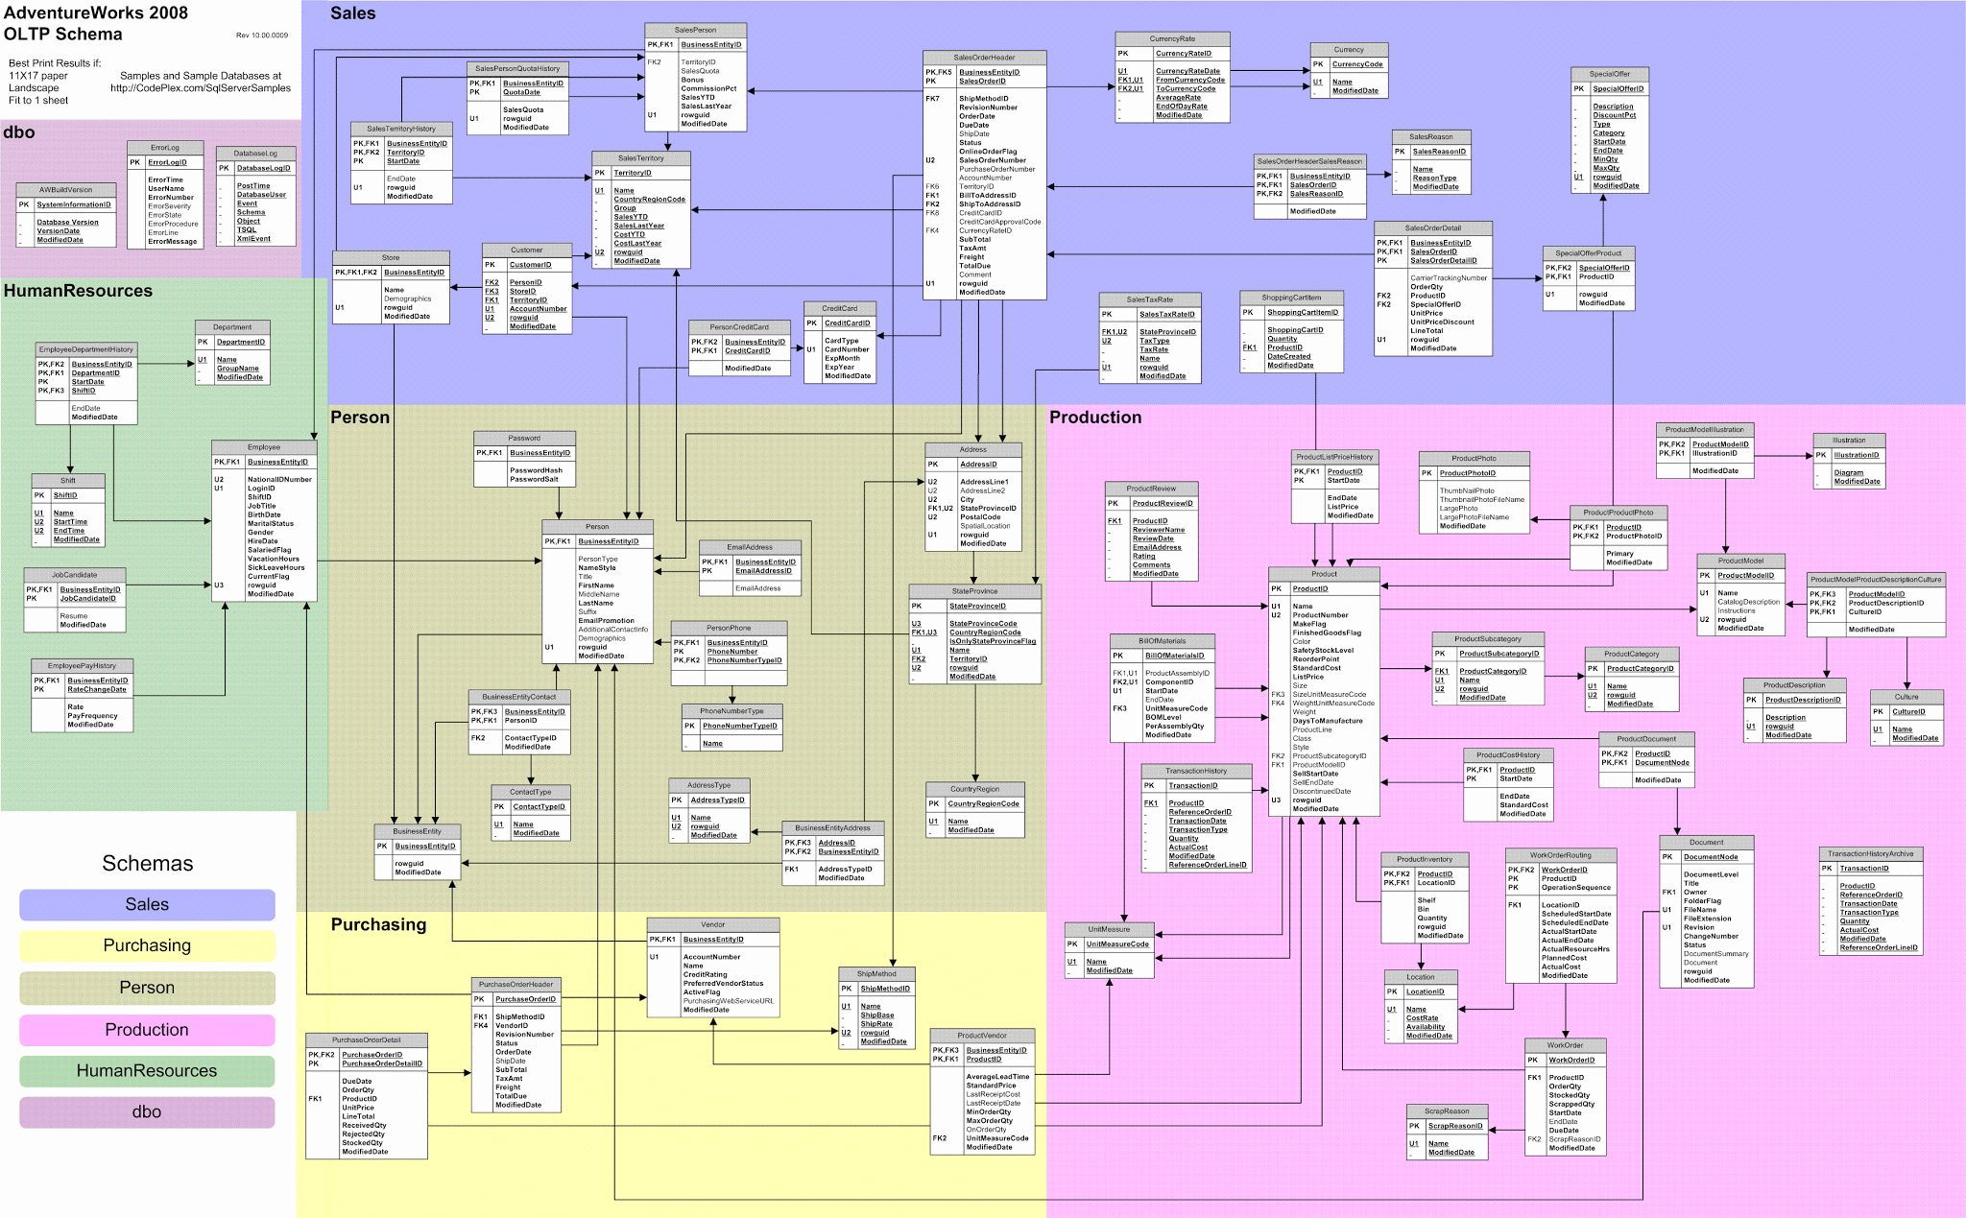
Notes:
Data dictionary: http://www.sqldatadictionary.com/AdventureWorks2012/database.html
Data set description: https://docs.microsoft.com/en-us/previous-versions/sql/sql-server-2008/ms124438(v=sql.100)
Diagram image link: https://i.stack.imgur.com/LMu4W.gif (note this is from 2012 and may be slightly different)
Talk about schema

Slide 31
JOINING MULTIPLE TABLES: PRACTICE NO. 1
Using salesorderheader as our primary table, create links to salesorderdetail, customer, specialoffer, salesterritory. The result should be one query with several JOINs.
Before going into SQL, practice wireframing your JOINs on a piece of paper.
(link to the db schema: https://i.stack.imgur.com/LMu4W.gif)
Your query should include the follow columns:
salesorderheader- salesorderid, totaldue
salesorderdetail- productid
customer- customerid
specialoffer- description
salesterritory- name
Limit results to 1,000.
EXERCISE
Notes:
SOLUTION
SELECT soh.salesorderid,
soh.totaldue,
sod.productid,
cust.customerid,
offer.description,
st.name
FROM sales.salesorderheader AS soh
INNER JOIN sales.salesorderdetail AS sod
USING(salesorderid)
INNER JOIN sales.customer AS cust
USING(customerid)
INNER JOIN sales.specialoffer AS offer
USING(specialofferid)
INNER JOIN sales.salesterritory AS st
ON soh.territoryid = st.territoryid
LIMIT 1000;

Slide 32
JOINING MULTIPLE TABLES: PRACTICE NO. 1 - SOLUTION
SELECT soh.salesorderid,
soh.totaldue,
sod.productid,
cust.customerid,
offer.description,
st.name
FROM sales.salesorderheader AS soh
INNER JOIN sales.salesorderdetail AS sod
USING(salesorderid)
INNER JOIN sales.customer AS cust
USING(customerid)
INNER JOIN sales.specialoffer AS offer
USING(specialofferid)
INNER JOIN sales.salesterritory AS st
ON soh.territoryid = st.territoryid
LIMIT 1000;
EXERCISE

Slide 33
JOINING MULTIPLE TABLES: PRACTICE NO. 2
Using several INNER JOINS create one query:
Tables:
salesorderheader
salesorderdetail
salesterritory
Answer the questions -
total order quantity and average total due by territory name.
Before proceeding, plan your JOINs out in a wireframe.
Your query should:
List the name (from salesterritory) and two aggregated columns: average totaldue (from salesorderheader) and sum orderqty (from salesorderdetail). (NOTE: Round the average to 2 decimal places)
Group the data by the territory name.
EXERCISE
Notes:
INSTRUCTOR NOTE: This activity is definitely on the challenging side. We recommend pairing or organizing students into small groups and then actively facilitating and assisting groups throughout.

Slide 34
JOINING MULTIPLE TABLES: PRACTICE NO. 2
Solution query without aliases:
SELECT st.name,
SUM(sod.orderqty) AS ttl_orderqty,
ROUND(AVG(soh.totaldue),2) AS avg_sales
FROM sales.salesorderheader AS soh
INNER JOIN sales.salesorderdetail AS sod
USING(salesorderid)
INNER JOIN sales.salesterritory AS st
USING(territoryid)
GROUP BY st.name;
EXERCISE
Notes:
SOLUTION
select sales.store, sales.category_name, round(avg(cast(products.bottle_price as decimal)),2) as avg_cost,
round(avg(sales.total),2) as avg_sales_price
from sales
inner join products
on sales.item = products.item_no
inner join stores
using(store)
where sales.category_name ilike '%tequila%' and (stores.store_address ilike '%mason city%' and store_status='A')
group by sales.store, sales.category_name
order by 1

Slide 35
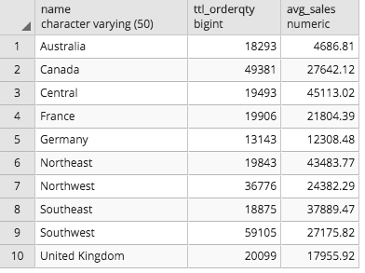
JOINING MULTIPLE TABLES: PRACTICE NO. 2
The results should look like:

Slide 36
JOINS & UNIONS IN SQL
CREDITS
UNION and JOIN graphical illustration from EssentialSQL.com: https://goo.gl/FQXykj.

Slide 37
JOINS & UNIONS IN SQL
RESOURCES
Microsoft reference material on UNIONs: https://docs.microsoft.com/en-us/sql/t-sql/language-elements/set-operators-union-transact-sql
INNER JOIN tutorial: http://www.sqltutorial.org/sql-inner-join/
“What is the Difference Between a JOIN and a UNION?”: https://www.essentialsql.com/what-is-the-difference-between-a-join-and-a-union/
“What is the difference between a primary and unique key?” https://www.essentialsql.com/primary-and-unique-key/

